Slide 1
History of smartphones
The proof that Apple did not invent the Smartphones, they just advertised enough, and soon everybody needed one for survival. ☺ Flame on!!! :P

Slide 2
IBM Simon

Slide 3
Nokia 9000

Slide 4
Ericson GS88

Slide 5
Symbian

Slide 6
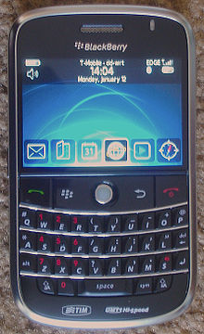
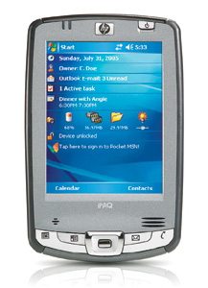
Palm OS BlackBerry OS Pocket PC

Slide 7
Palm Kyocera 6035

Slide 8
1st BlackBerry

Slide 9
HTC Touch Cruise

Slide 10
iPhone

Slide 11
HTC Dream

Slide 12
Windows Phone

Slide 14
Sources
http://en.wikipedia.org/wiki/Smartphone
And a lot more wiki pages
Google

